Slide 1


Lesson 3
Emma’s school
UNIT 1

Slide 2
How many subjects have you got this year?
Is that more or fewer than the last year?
Which of them are you good at?
Draw a mind map.
Write as many school subjects as you can think of.
MATH
ART
CHEMISTRY
PHYSICS
PE
LITERATURE
LANGUAGE
SCHOOL SUBJECTS

Slide 3

Do you attend any extracurricular activities?
EXTRACURRICULAR ACTIVITIES (IZVANNASTAVNE AKTIVNOSTI)
choir – zbor
drama group – dramska skupina
chess – šah
IT - informatika
first aid – prva pomoć
robotics – robotika
orchestra - orkestar
Photo by Geoffrey Whiteway
Photos courtesy of and copyright Free Range Stock, www.freerangestock.com
(https://freerangestock.com/photos/38809/science-background.html)

Slide 4
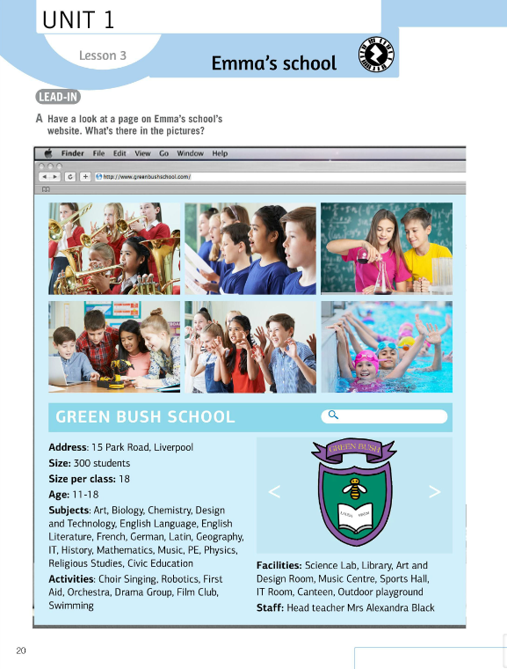

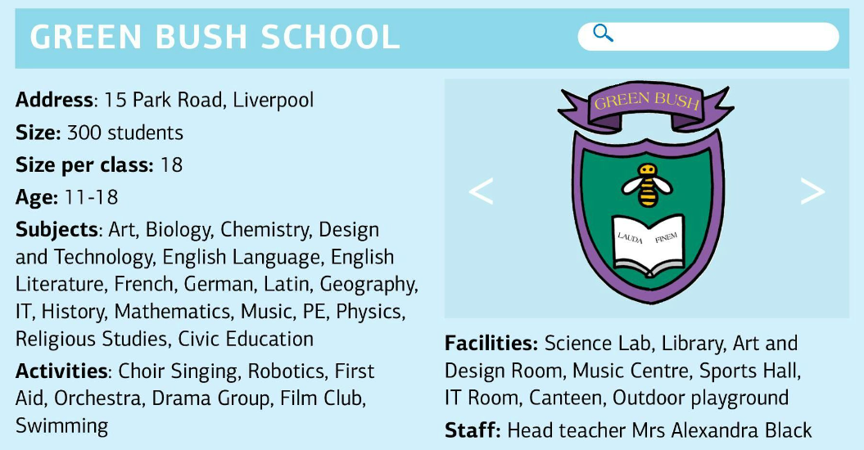
Have a look at a page on Emma’s school’s website. What’s there in the pictures?
Look at the coat of arms for Green Bush School. What can you see?
Read the text and find out more about Emma’s school.

Slide 5
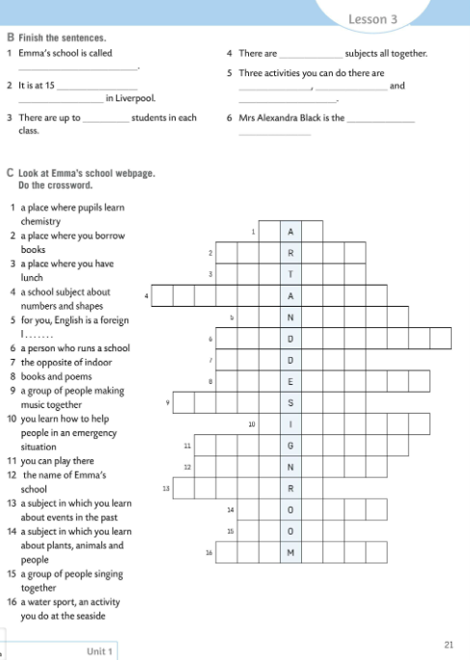
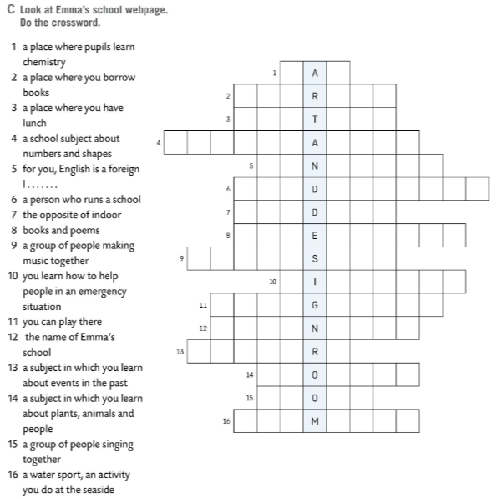
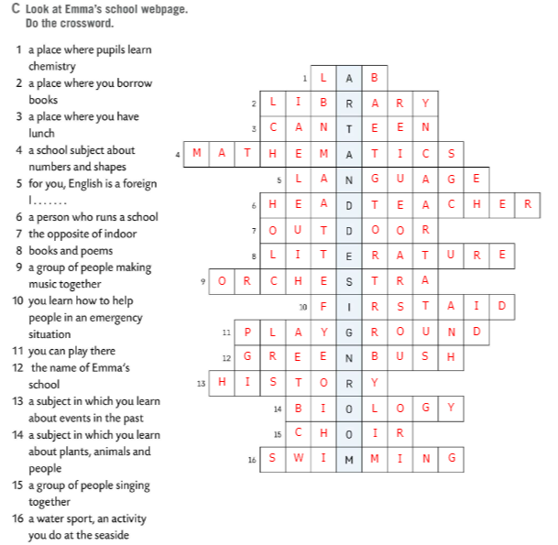
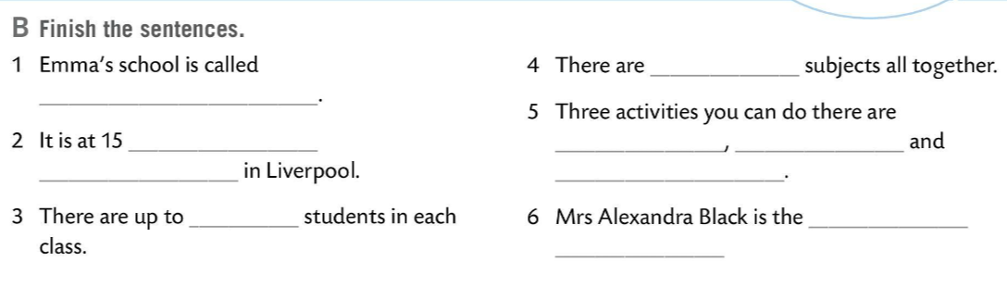
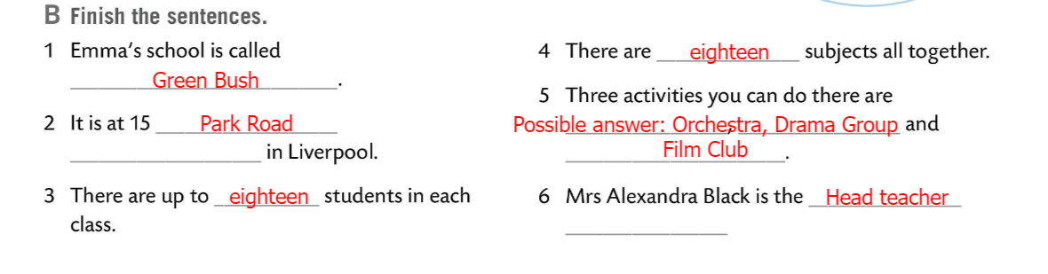
Read the text once again and finish the sentences in Task B.
Check.
Look at Emma’s school webpage. Do the crossword.
Check.

Slide 6
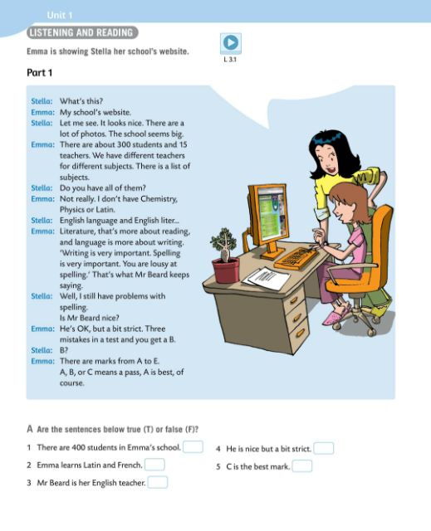
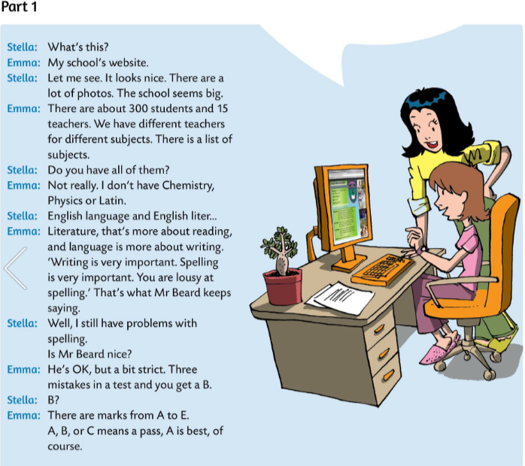

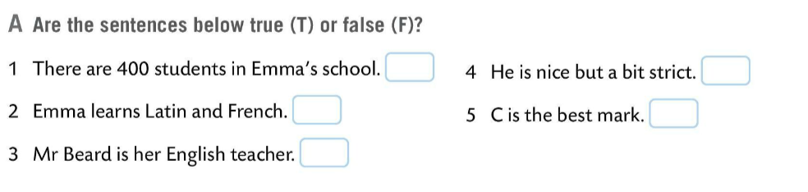
Emma is showing Stella her school website.
Listen to the conversation and then read the text.
Are the sentences in Task A true (T) or false (F)?
Read the text once again and write T or F.
Check.
F (300)
T
F (She doesn’t learn Latin.)
F (A)
T

Slide 7
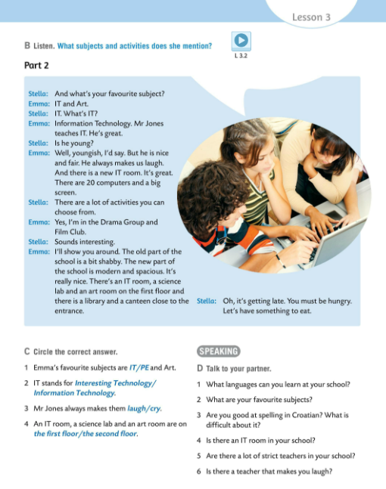
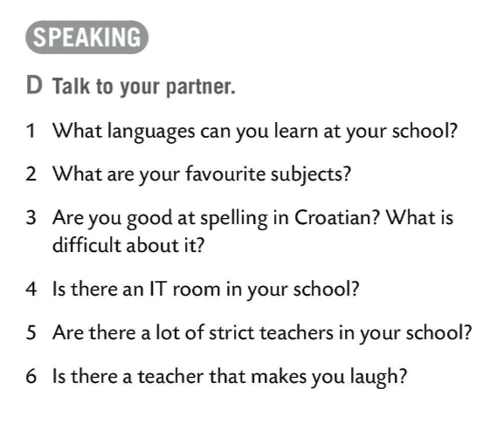
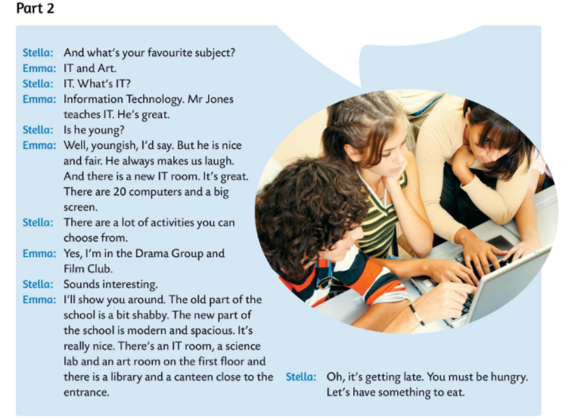
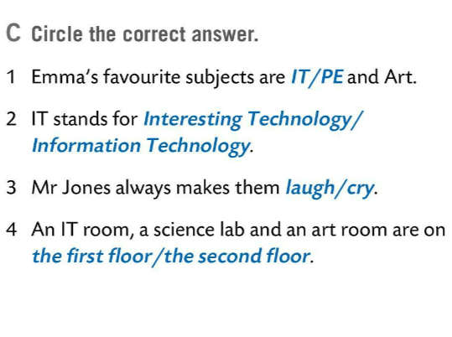

Listen to the conversation between Stella and Emma. Try to remember what subjects and activities Emma mentions.
Listen to the recording again and circle the correct answer in Task C.
Check.
Talk to your partner about your school. Ask and answer questions in Task D.

Slide 8
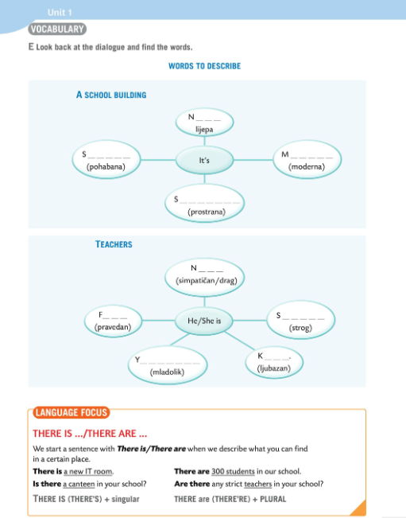
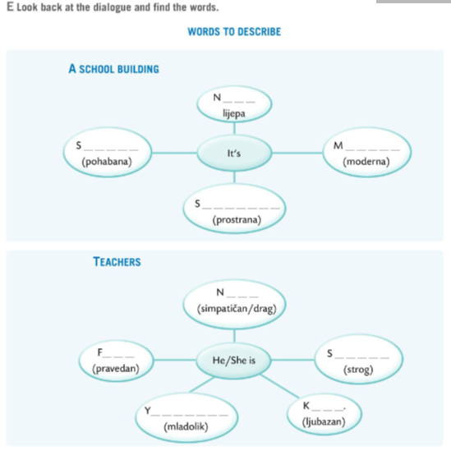
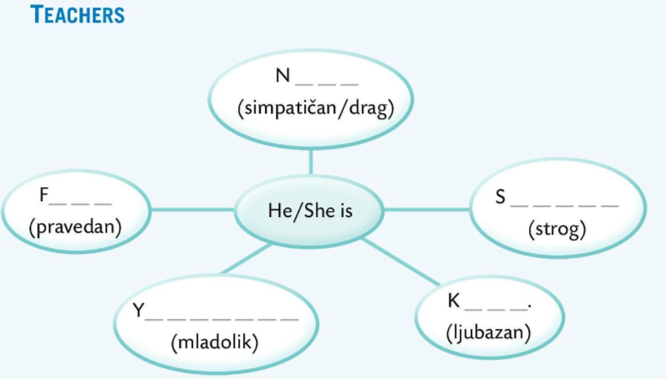
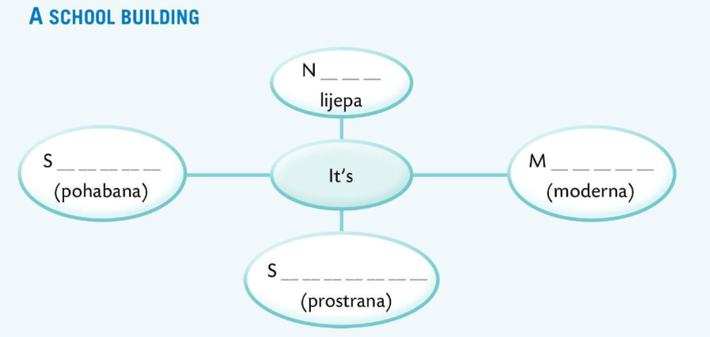
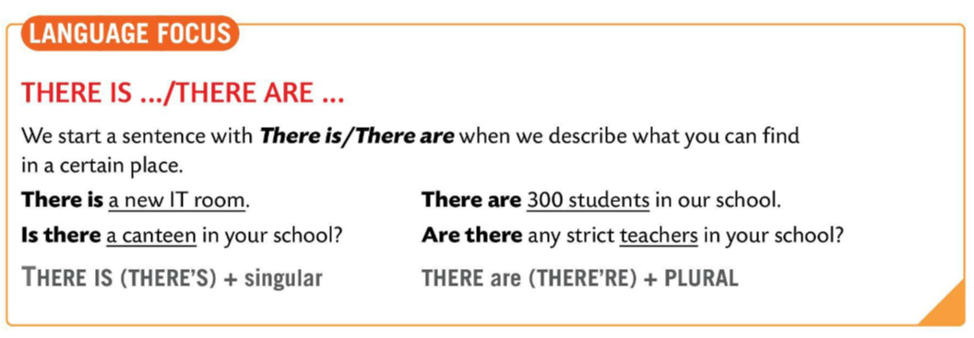
Look back at the dialogues and find the words to describe school buildings and teachers.
When you find the words, write them in the correct mind map in Task E.
I C E
I C E
Check.
H A B B Y
O D E R N
LANGUAGE FOCUS
We start a sentence with THERE IS or THERE ARE when we describe what you can find in a certain place./ Rečenicu započinjemo s THERE IS ili THERE ARE kada opisujemo što se nalazi na kojem mjestu.
A I R
T R I C T
P A C I O U S
O U N G I S H
I N D

Slide 9
Look at the examples.
There is a new IT room.
Is there a canteen in your school?
There are 300 students in our school.
Are there any strict teachers in your school?
We use THERE IS (THERE’S) with singular and THERE ARE (THERE’RE) with plural nouns
THERE IS (THERE’S) koristimo s imenicama u jednini, a izraz THERE ARE (THERE’RE) s imenicama u množini.

Slide 10
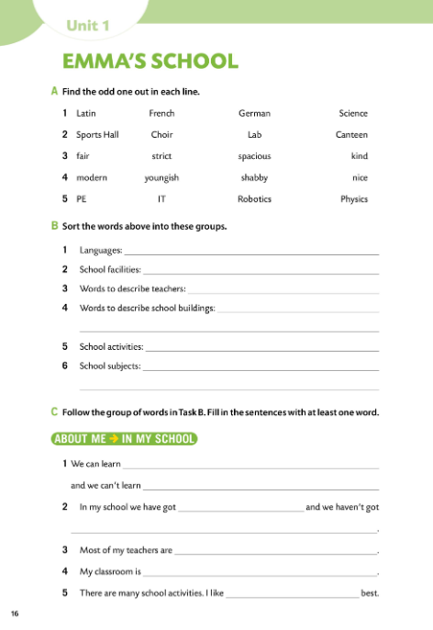

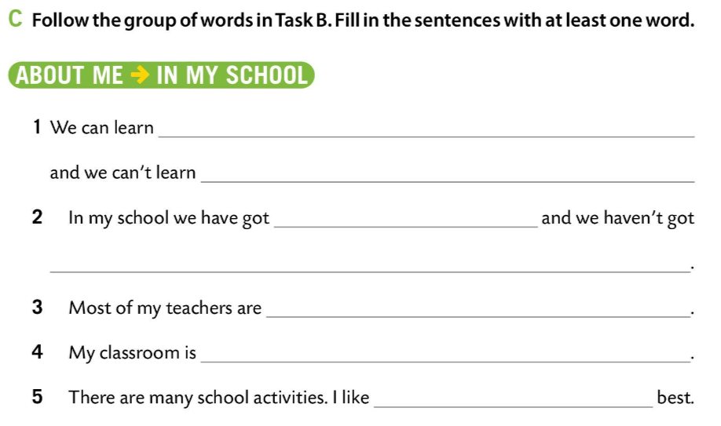
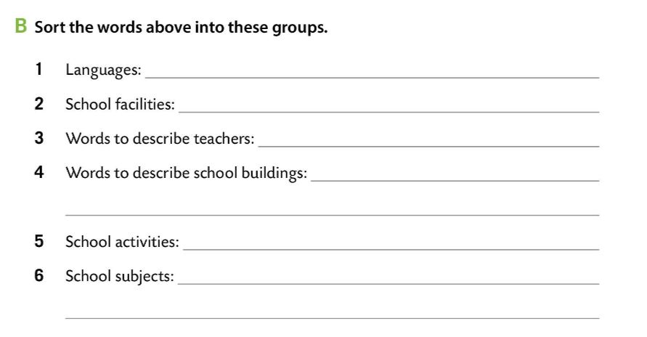
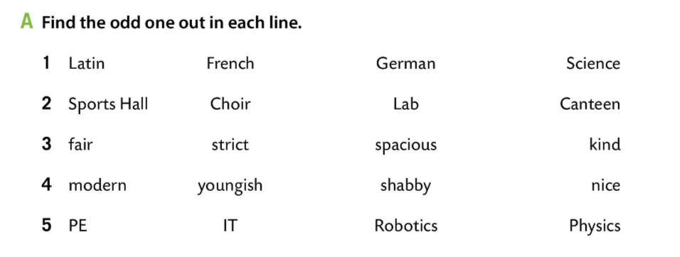
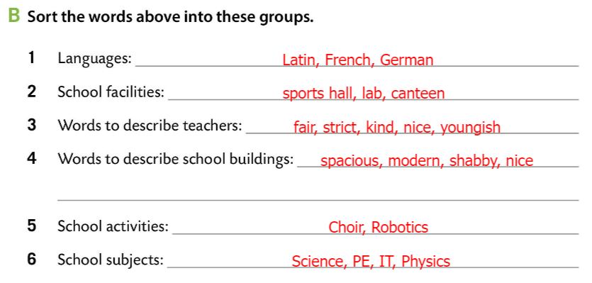
Workbook, page 16.
Find the odd one out in each line in Task A.
Check.
Sort the words from Task A into the groups in Task B.
Check.
Fill in the gaps in Task C with your own answers. Use the vocabulary you have just learnt.

Slide 11
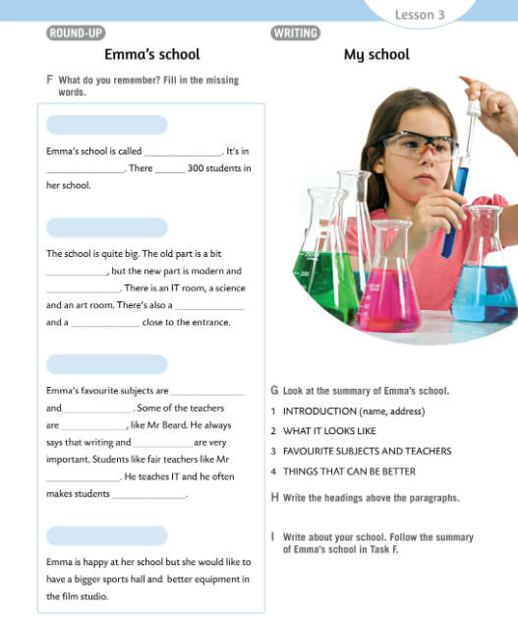
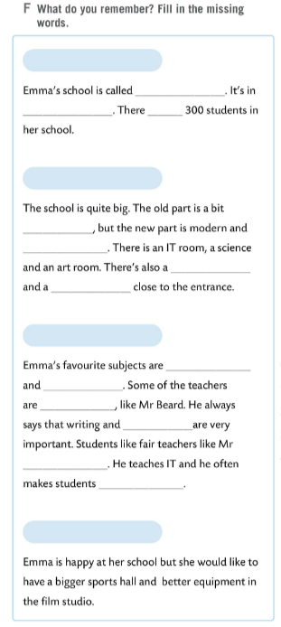
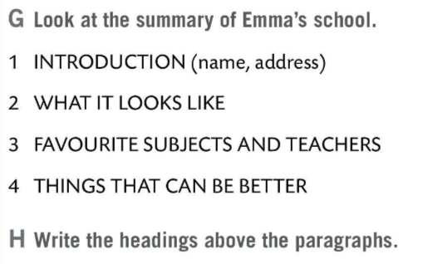
Let’s revise!
Play the game. https://wordwall.net/play/510/624/545
Task F. What do you remember?
Fill in the missing words.
INTRODUCTION (name, adress)
Green Bush
Liverpool
are
WHAT IT LOOKS LIKE
shabby
spacious
IT room
science lab
FAVOURITE SUBJECTS AND TEACHERS
IT
Art
Check.
strict
spelling
Read the summary of Emma’s school and write the headings from Task G above the paragraphs in Task F.
Jones
laugh
THINGS THAT CAN BE BETTER
Check.

Slide 12
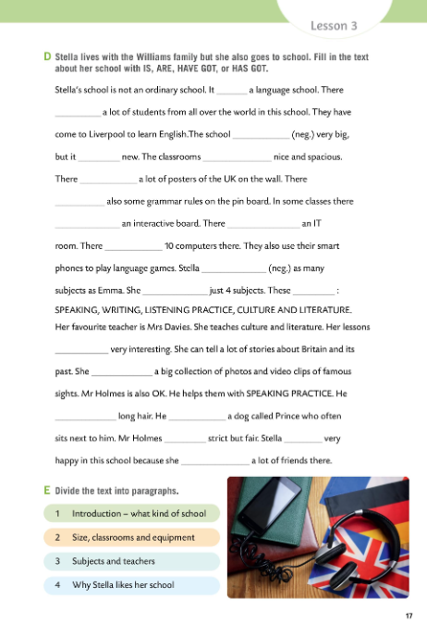
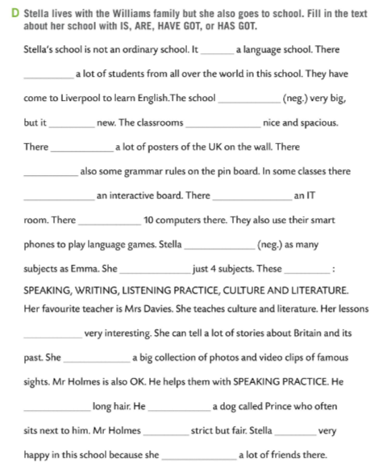
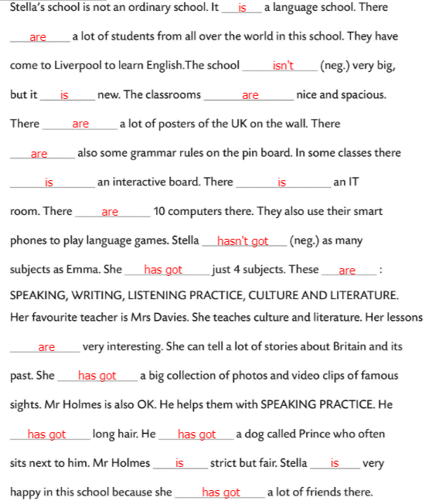
Workbook, page 17.
Stella lives with the Williams family but she also goes to language school.
Fill in the text in Task D with IS, ARE, HAVE GOT, or HAS GOT.
Check.

Slide 13
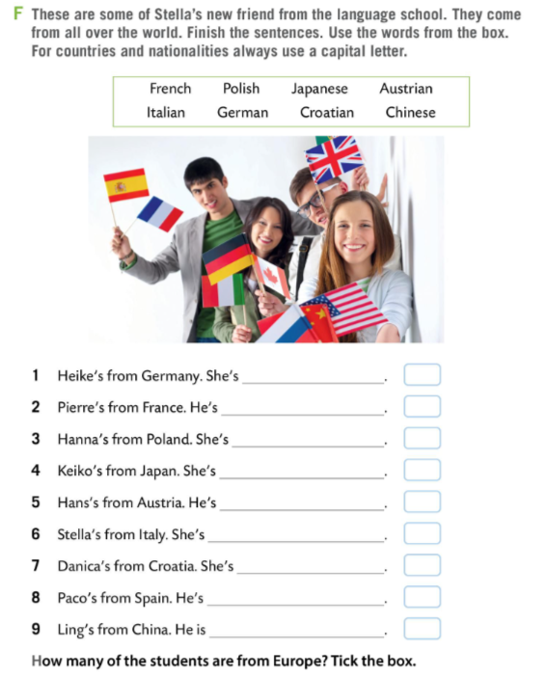
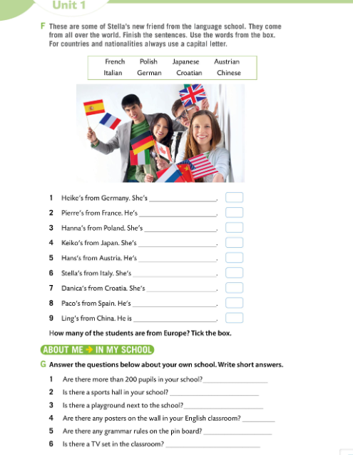

Workbook, page 18.
In the picture you can see Stella’s new friends from the language school. They come from all over the world.
Use the words from the box and finish the sentences in Task F.
Put a tick next to the students who are from Europe.
FOR COUNTRIENS AND NATIONALITIES ALWAYS USE A CAPITAL LETTER.
NAZIVE DRŽAVA I STANOVNIKA TIH DRŽAVA UVIJEK PIŠEMO VELIKIM POČETNIM SLOVOM.
German
French
Polish
Japanese
Austrian
Italian
Croatian
Spanish
Chinese
Check.

